Slide 2
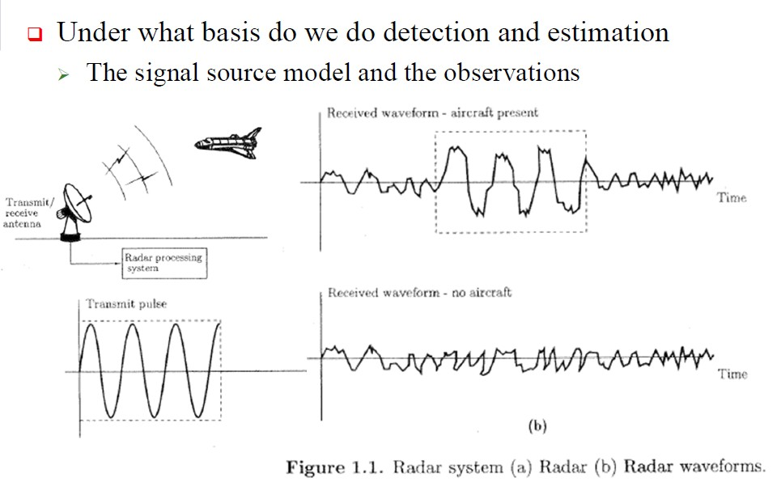
3rd Year
Detection and Estimation Theory
Dept. of Communications Eng.
2. Detection Theory and Estimation Theory.

Slide 3
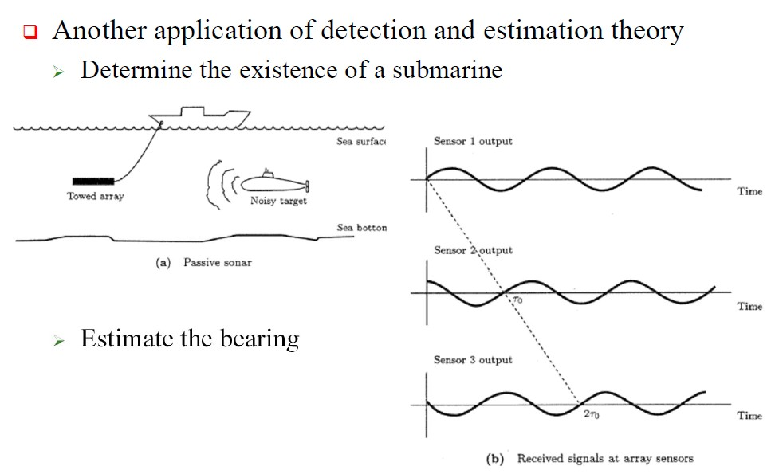
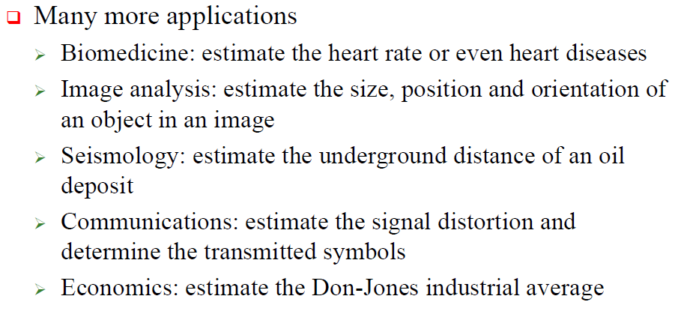
3rd Year
Detection and Estimation Theory
Dept. of Communications Eng.

